Slide 1

A More Agile, Adaptable Pedagogy— Helping Students Develop Literacy & Self-Regulation Skills
Cynthia Eaton
Professor of English, Suffolk County Community College
Secretary, Faculty Association of Suffolk Community College, NYSUT - AFT/NEA Local 3038
Notes:
This is the presentation I offered for the National Education Association on May 7, 2020, about helping students develop their literacy and self-regulation skills online. I’ve taught online courses nearly every single semester since spring 1998 and was asked to share some info and advice to help faculty across the nation who had to move to remote learning with little notice due to the coronavirus pandemic.

Slide 2
Two critical aspects that
make the difference
between learning online
and learning on campus:
students need stronger
literacy & self-regulation skills.
Notes:
Despite those who claim there’s really no difference between learning on campus and learning online, my research and experience shows that there two critical differences: In online courses, students need more effective literacy and self-regulation skills. Thus, NEA asked me to share some advice about how to help online students work on developing these.

Slide 3
A More Agile, Adaptable Pedagogy—Helping Students Develop Literacy and Self-Regulation Skills
Literacy The majority of online courses still rely more heavily on text, which means there’s greater weight on student literacy skills—their reading and writing skills—to succeed compared with on campus, where their listening and speaking skills come into play more.
Self-Regulation On campus, there’s some regulation built in, as students are in a physical space on a set schedule, like Mon/Wed 11-12:15, and hear the professor’s verbal reminders. Online, however, they need to make themselves log in on a regular, frequent basis and complete their assignments in a timely fashion.
Notes:
Even as faculty incorporate more video and audio into their online courses, they remain largely text heavy, which means students need stronger reading and writing skills to succeed. They also need to be more self-regulated or more self-directed in fully online courses. These aren’t skills that are typically very high among the majority of community college students, e.g., the NCES shows that in 2015, only 37% of high school graduates achieved NAEP proficiency or advanced proficiency in reading (https://nces.ed.gov/programs/coe/indicator_cnb.asp).

Slide 4
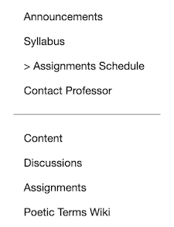
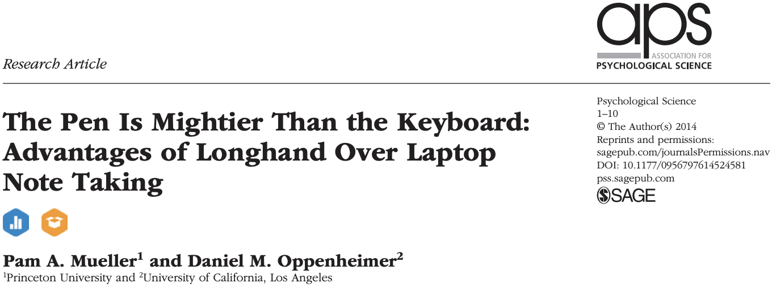
A More Agile, Adaptable Pedagogy—Helping Students Develop Literacy Skills
Teach students to take notes by hand as often as possible, to “read with a pen.”
Note taking can be generative, as when students summarize or paraphrase information, or nongenerative, when students copy information verbatim.
  Handwriting — students write less because they’re more selective about what they’re writing
  Typing — students write more verbatim so they’re less selective about what they’re writing
Handwriting requires greater cognitive processing which improves learning and retention of information. (*If being tested on factual information/recall only, however, learning is about the same.)
Does taking more notes result in improved test scores? Not in this study: more words copied verbatim
led to worse performance.
When students reviewed notes between
lecture and test, handwriting students
still performed better.
Physically writing notes by hand improves
students’ encoding functions which
enhances their learning.
Notes:
I talk with my students a lot about how, even though it may feel counterintuitive, it’s critical that they develop the habit of “reading with a pen.” I teach them the value of using print materials whenever possible and to annotate margins as they read and to take notes on pen and paper. This is one study that shows the benefits of handwritten notes. (Click the image to access the article.)

Slide 5
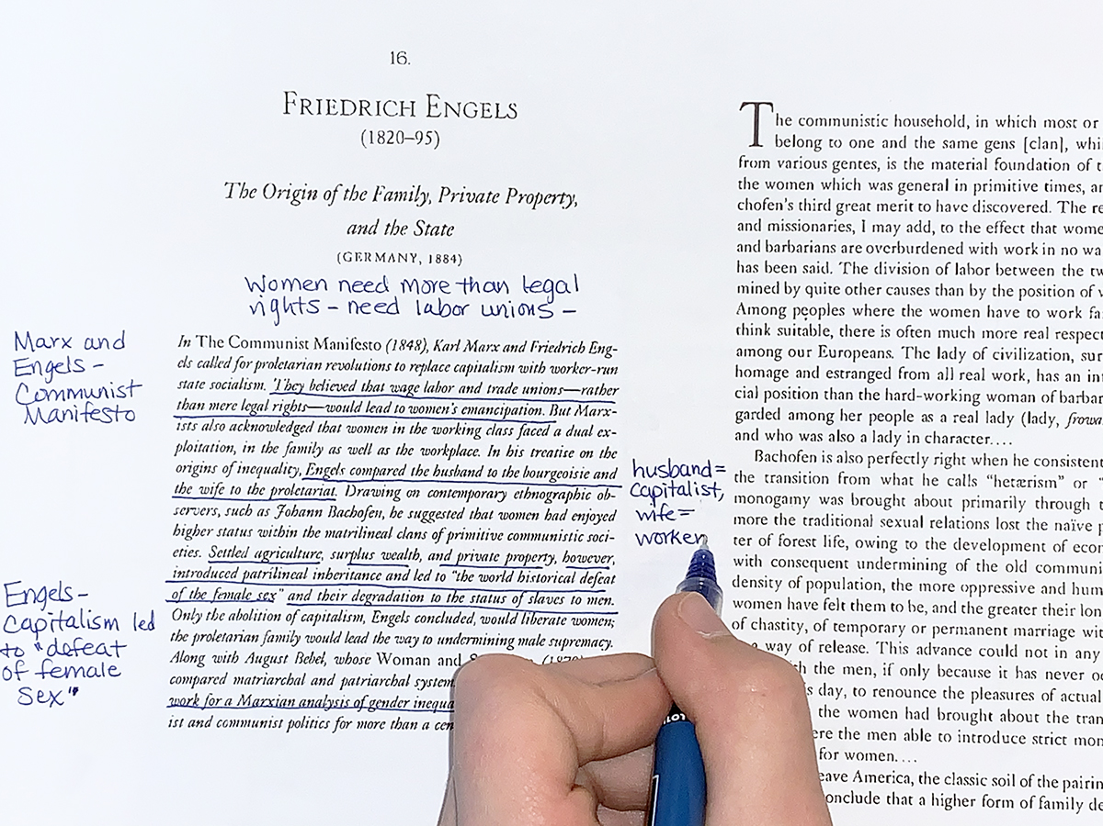
A More Agile, Adaptable Pedagogy—Helping Students Develop Literacy Skills
Annotate using descriptive outlines.
Just as with taking notes by hand, literacy and
composition research shows that writing descriptive
outlines results in greater reading comprehension.
A descriptive outline is when students make a brief
note in the margin by paraphrasing each paragraph
or section. Teach students to summarize “what is
the author saying or doing right here?” This forces
students to slow down, interact with the text, read
more actively which improves focus, and note
places where they have questions.
Notes:
How often do you feel like your students just aren’t doing the readings? It might be the case that they are reading but aren’t really comprehending what they read. Even though many professors feel that they have too much content to cover in each of their classes and don’t want to cut anything, I believe it’s more beneficial to make time to teach students how to study, how to read with their pen, how to annotate their readings with descriptive outlines to get them actively engaging with readings.

Slide 6
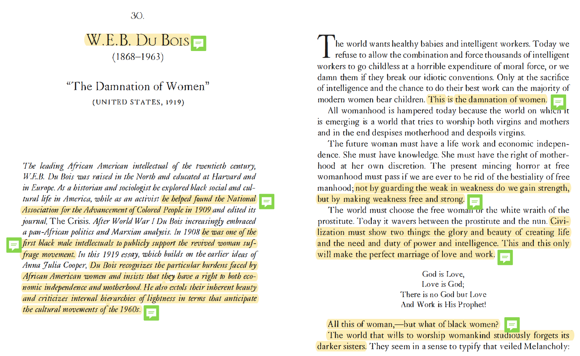
A More Agile, Adaptable Pedagogy—Helping Students Develop Literacy Skills
If students are able to print —
Consider typing and posting your materials using the Calibri or Calibri Light font because these use less ink than others (like Arial), but they are still ADA compliant.
Tell students about sites like Print Friendly to
remove color ads and images from webpages you
refer them to.
If students are not able to print —
Students can annotate online using Adobe Reader
for pdfs or, for other source types, try these:
    hypothes.is (Blackboard integration)
    Diigo
    Scrible
    Pundit
    Notable
Notes:
I know that not all students have access to a printer at home or can afford the expense of ink! So here are some options to help them. For student who can print, make your materials printer friendly. For those who cannot, you can use Hypothesis, which is now integrated into Bb! Click Content > Add Content, and you’ll see it at the lower left of the screen. I’ve written an article about it in The WORD (http://www.fascc.org/theword/). The Du Bois image here shows how pdfs look when share my highlights and annotations in Adobe Acrobat. If students wish to see my annotation, they can hover over the green boxes to see my comments, questions, and explanations. Or, if they want to read without that assistance, they can choose to NOT click those green boxes (or click only the ones where they feel they need a little nudge).

Slide 7
A More Agile, Adaptable Pedagogy—Helping Students Develop Literacy Skills
Learn how to write for the web.
Chunk your content. Chunking makes your content more scannable by breaking it into manageable sections.
Front load the important information. Use the journalism model of the “inverted pyramid.” Start with the content that is most important to your audience, and then provide additional details.
Use pronouns. The user is “you.” This creates cleaner sentence structure and more approachable content.
Use active voice. “The board proposed the legislation” not “The regulation was proposed by the board.”
Use short sentences and paragraphs. The ideal standard is no more than 20 words per sentence, five sentences per paragraph. Use dashes instead of semi-colons or, better yet, break the sentence into two.
Use bullets and numbered lists. Don’t limit yourself to using this for long lists—one sentence and two bullets is easier to read than three sentences.
Use clear headlines and subheads. Questions, especially those with pronouns, are particularly effective.
Use images, diagrams, or multimedia to visually represent ideas in the content. Videos and images should reinforce the text on your page.
Use white space. Using white space allows you to reduce noise by visually separate information.
Notes:
This is advice from the federal government about writing for the web, which can help make your writing more readable for your students.

Slide 8
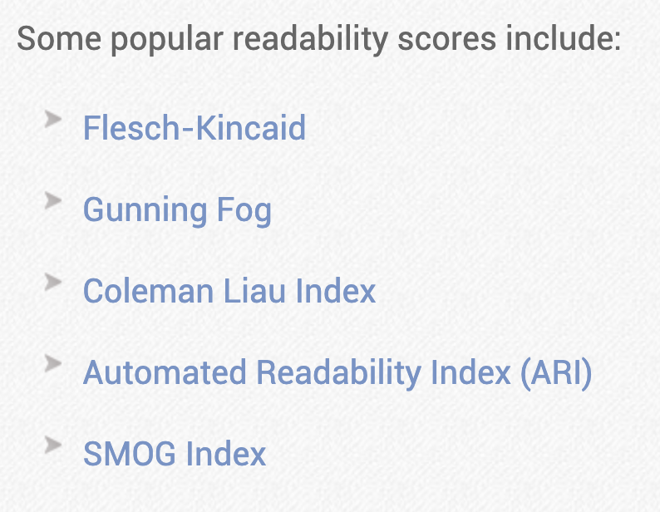
A More Agile, Adaptable Pedagogy—Helping Students Develop Literacy Skills
Learn how to test your own writing’s readability.
  WebFX Readability Test Tool
  Readable
  Readability Formulas
Copy and paste some of your text or enter a
webpage address.
These sites will run a test of your
text and give you readability scores based on
a variety of popular measures (shown at right).
For general audiences, an 8th grade readability
score is the goal. Adjust it to your audience.
Notes:
These tools also can help you make sure your materials are at the right readability level.

Slide 9
A More Agile, Adaptable Pedagogy—Helping Students Develop Self-Regulation Skills
Self-regulation
  self-regulation (American Psychological Association)
    n. the control of one’s behavior through the use of self-monitoring (keeping a record of behavior), self-evaluation (assessing the information obtained during self-monitoring), and self-reinforcement (rewarding oneself for appropriate behavior or for attaining a goal).
  Online Self-Regulated Learning Questionnaire (OSLQ)
  Barnard, Lucy, William Y. Lan, Yen M. To, Valerie Osland Paton, Shu-Ling Lai. “Measuring self-regulation in online and blended learning environments.” The Internet and Higher Education, vol. 12, no. 1, 2009, pp. 1-6.
  OSLQ consists of six sub-scales measuring online self-regulation strategies:
    task strategies goal setting
    help seeking self-evaluation
    environment structuring time management
Notes:
Now looking at self-regulation, there are several elements that impact students’ success in online courses. The OSLQ is a helpful tool that focuses on six sub-scales.

Slide 10
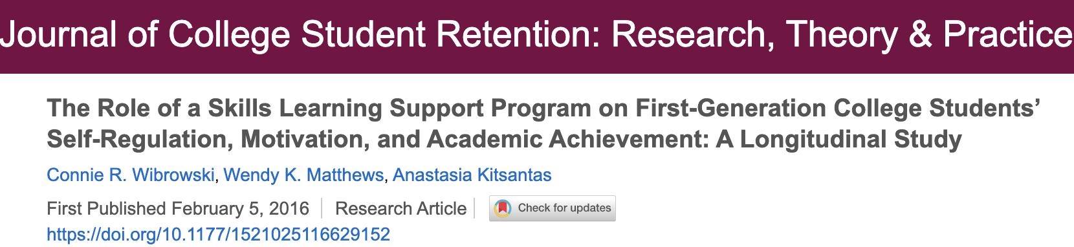
A More Agile, Adaptable Pedagogy—Helping Students Develop Self-Regulation Skills
Research support
2016 — Skills Learning Support Program — Journal of College Student Retention
Longitudinal study about SLSP program to help first-generation college students from ethnically diverse backgrounds
137 students receiving academic, counseling, and financial support — with 739 students in control group
SLSP program focused on helping students learn skills in self-regulation, motivation, and academic achievement
Assessed all students throughout four years
SLSP students showed higher levels of academic achievement by end of first year: same or even higher than non-program students
Same results
as SLSP
students
approached
graduation
Notes:
Research shows that actively teaching our students not only our content but also how to learn does result in improved student outcomes, as shown in this study.

Slide 11
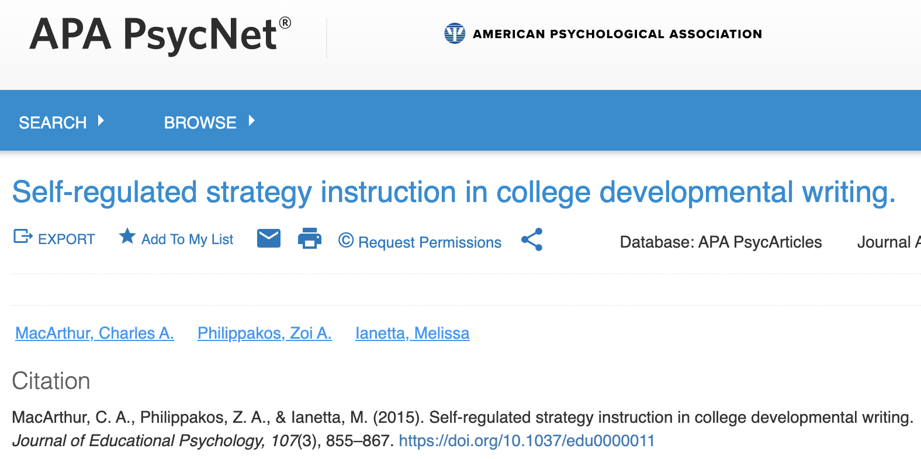
A More Agile, Adaptable Pedagogy—Helping Students Develop Self-Regulation Skills
Research support
2015 — Study of self-regulated strategy instructions in developmental writing — Journal of Educational Psychology
Study looking at impact of curriculum designed to incorporate self-regulated strategy instruction
Focused on college developmental writing classes
13 instructors, 276 students in 19 developmental writing classes at 2 universities, with 10 control classes
Students were explicitly taught strategies for planning,
drafting, and revising their writing as well as strategies
for self-regulation
Statistically significant positive effects for persuasive
essay and for essay development (but not grammar)
Statistically significant positive effects also found for
self-efficacy and mastery motivation
Notes:
Here’s another example of a study in developmental writing that shows how teaching the course content along with self-regulation techniques found positive impacts for students’ writing skills plus self-efficacy and mastery motivation.

Slide 12
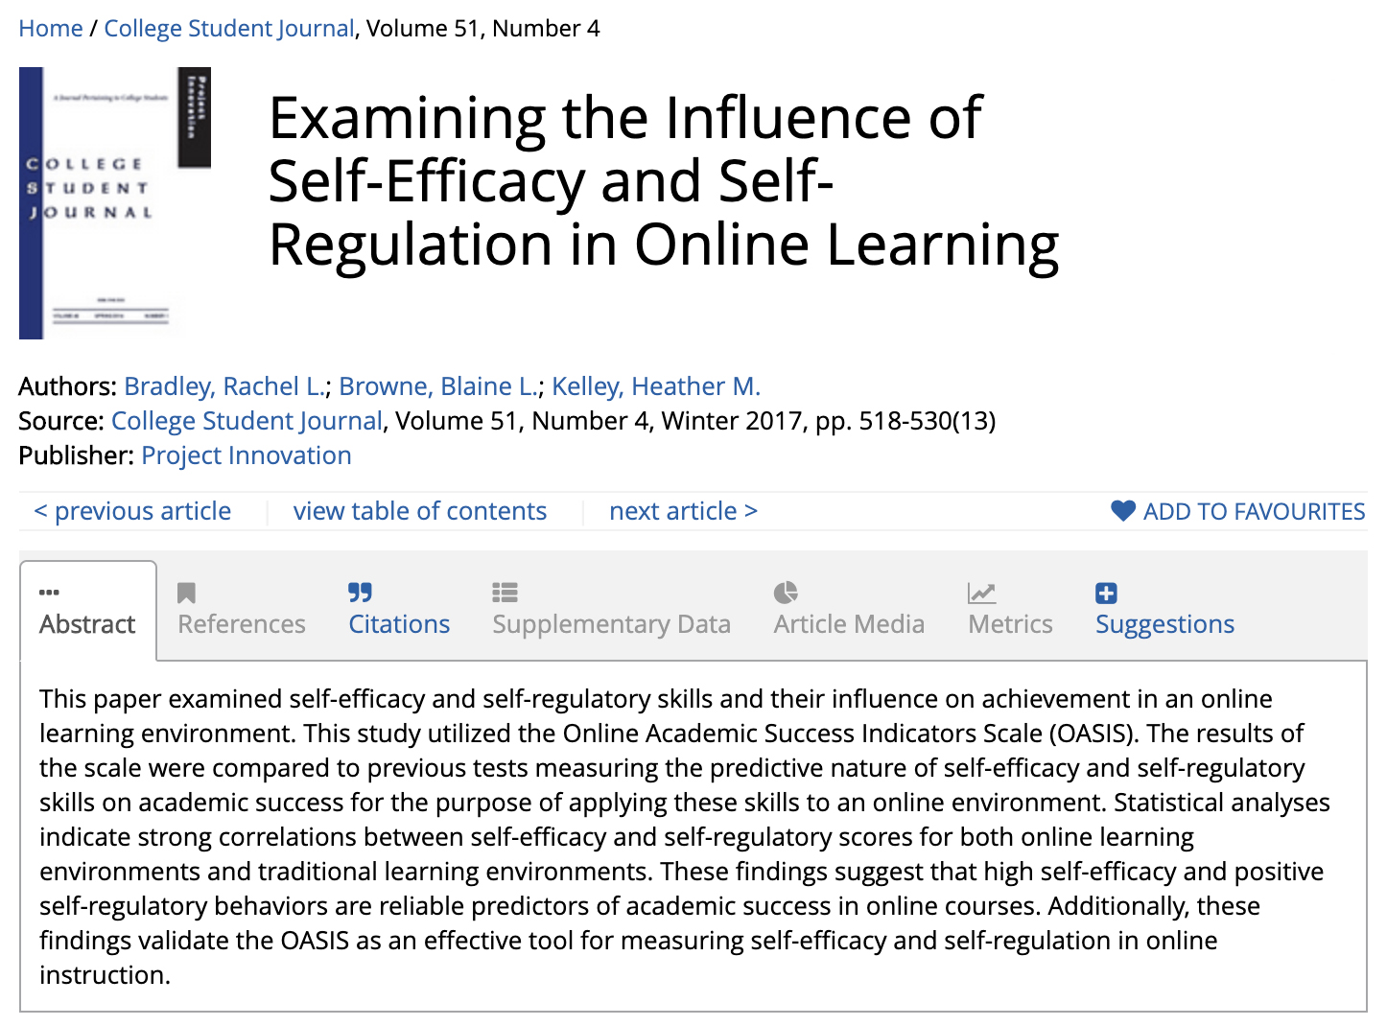
Notes:
Again, all of this matters even more on an online environment!

Slide 13

A More Agile, Adaptable Pedagogy—Helping Students Develop Self-Regulation Skills
Schedule management matters!
Explicitly advise students that now is the time to build and manage their own schedules—better than they ever have before. Doing so can be calming for students and give them some sense of control (esp. now that things feel really out of control).
Students may have electronic planners or calendars
that they use, and those may function well, especially
if they like to have alarms or reminders set to go off
at specific times.
There’s also something to be said for planning with
pen and paper. This can be a good time to develop
a habit of jotting a to-do list on index cards, post-it
notes or any scraps of paper.
There’s something satisfying about shredding
that paper when you’ve completed your list—and, as
we’ve seen, research shows that the physical act of
writing by hand better commits each item to your
memory.
Notes:
It’s useful too to have conversations with students about figuring out what schedule management techniques work for them. I open up a discussion forum where students share ideas with one another. They know about all kinds of apps and websites and features on their devices that I’ve never heard of.

Slide 14

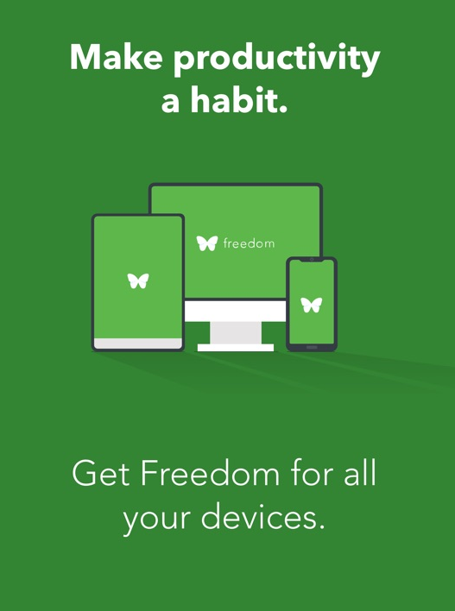
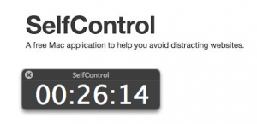
A More Agile, Adaptable Pedagogy—Helping Students Develop Self-Regulation Skills
Manage procrastination.
Advise them to find the quietest space they can at home. If listening to music helps,
that’s great. But assure them the research is clear that successful multitasking is
largely a myth. To limit distractions, here are some time management websites to
share:
StayFocusd is a free Chrome extension that helps students limit access
on time-wasting sites.
SelfControl is a Mac app that limits time on sites you enter;
Windows users can try Freedom.
Teach them to set goals for themselves. They could try the
Pomodoro Technique: Every 25 minutes, reward yourself with a very
short break. After four “pomodoros,” give yourself a longer break.
Make sure at least one involves some form of physical exercise
(like a quick ten-minute walk), stretching, or meditating.
Notes:
I also have frank conversations with students about procrastination, not about avoiding it but managing it. Above are a few of the better rated tools that I’ve shared with students.

Slide 15
A More Agile, Adaptable Pedagogy—Helping Students Develop Self-Regulation Skills
Manage “writer’s block.”
As an English professor, I know one thing students often procrastinate is getting started on writing assignments. Boy, do I know that! They’ll call it “writer’s block,” but I think it’s really that they’ve learned to hate writing—because clear, concise, compelling writing is hard work.
Here’s a trick that often helps my students. When faced with a writing assignment, tell them to try either turning off their monitor or darkening their screen to the point where they cannot see what they’re typing.
Then have them just start typing. Really. Start writing everything they think they know about the topic or want to say in response to the assignment. The draft is going to be messy when they look at it in the light again, but writing is its own heuristic and the best way to get started is simply by getting started.
They’ll have to spend some time cleaning up their messy draft, but that’s a lot better than wasting hours staring mindlessly at a blank screen or starting the essay two hours before it’s due. And students often surprise themselves with how much they do have to say.
Notes:
And, naturally, I cannot resist talking with students about what they call “writer’s block,” which is really just procrastination or outright avoidance. Here another one of my favorite bits of advice is to have students write their early drafts with their laptop or computer screens darkened so they cannot see what they’re typing. This way, they can at least get some ideas down in a draft so we can start a conversation about it.

Slide 16
Contact me
Cynthia Eaton
cynthia@fascc.org
National Education Association webinars
Part 1 — A More Agile, Adaptable Pedagogy —
Designing and Organizing Your (Suddenly) Online Course
Part 2 — A More Agile, Adaptable Pedagogy —
Helping Students Develop Literacy & Self-Regulation Skills

