Slide 1

A More Agile, Adaptable Pedagogy— Organizing & Structuring Your Online Course
Cynthia Eaton
Professor of English, Suffolk County Community College
Secretary, Faculty Association of Suffolk Community College, NYSUT - AFT/NEA Local 3038
Notes:
This is the presentation I offered for the National Education Association on April 24, 2020, about getting started with teaching online. I’ve taught online courses nearly every single semester since spring 1998 and was asked to share some info and advice to help faculty across the nation who had to move to remote learning with little notice due to the coronavirus pandemic. (Since it was a national webinar, I didn’t make everything specific to Blackboard as I can here at SCCC.)

Slide 2
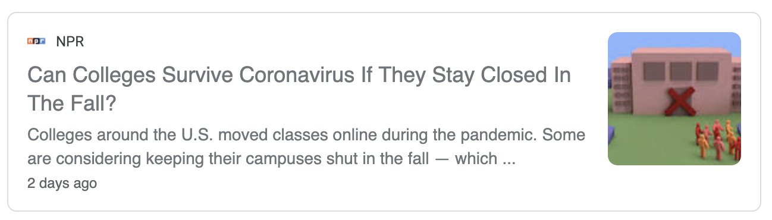
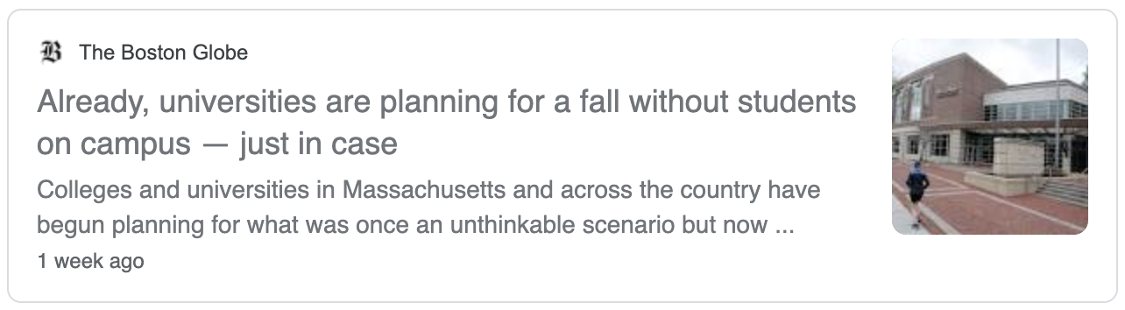
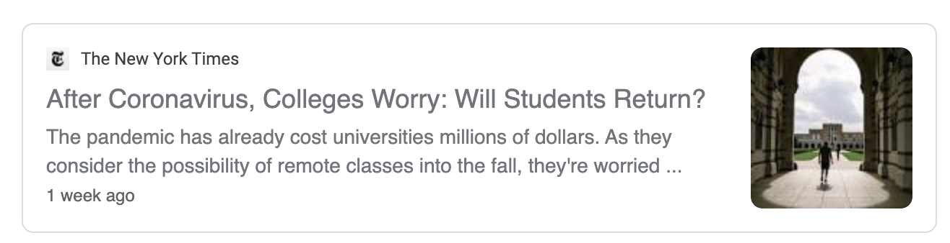
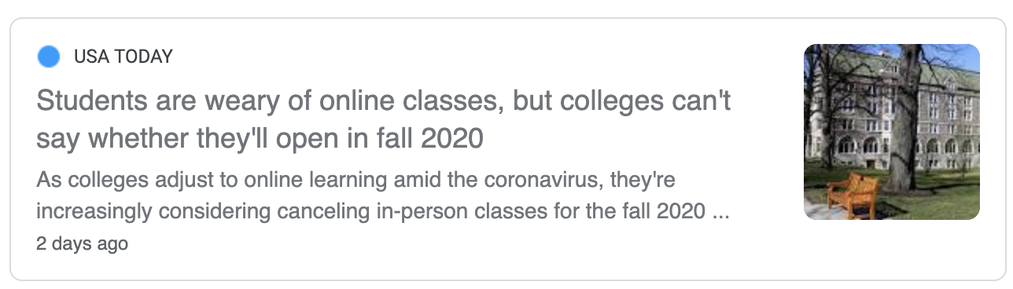
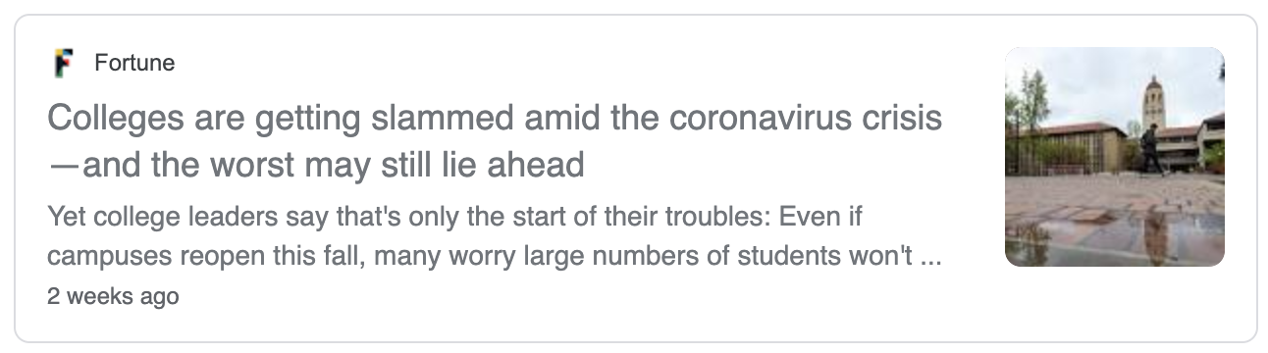
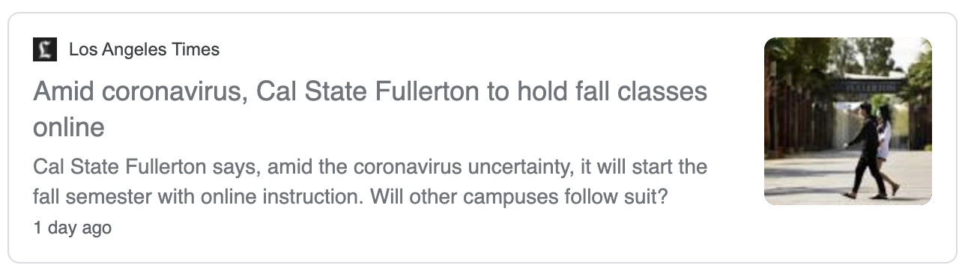
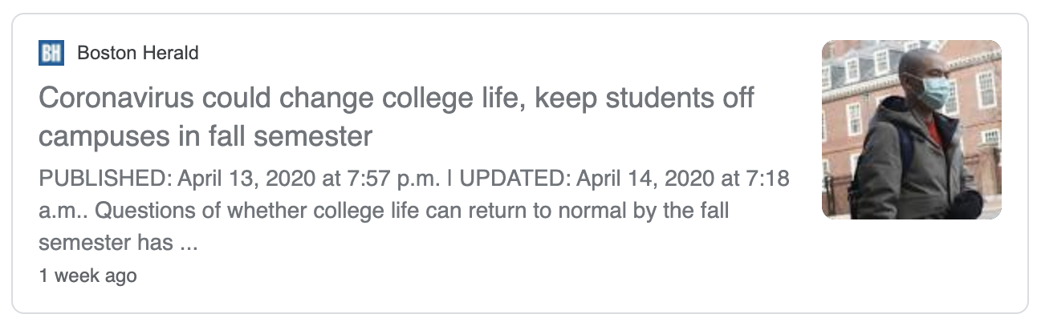
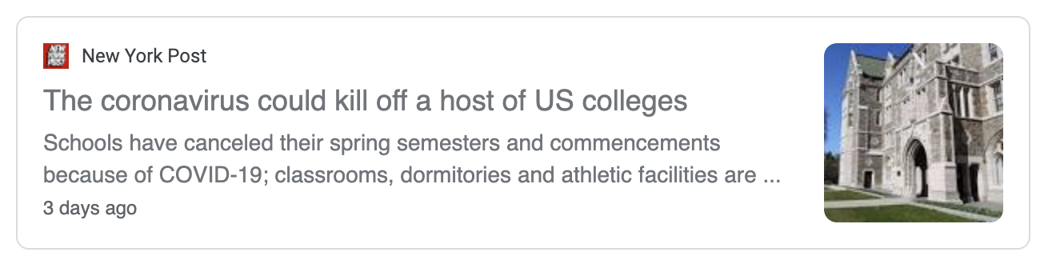
Notes:
These headlines shows that there are plenty of suggestions that we might be online again for all or part of the fall 2020 term.

Slide 3
“Hoping for the best, prepared for the worst, and unsurprised by anything in between.”
~ Maya Angelou, I Know Why the Caged Bird Sings
Notes:
I share this information in the spirit of trying to help colleagues be as prepared as possible for future semesters.

Slide 4
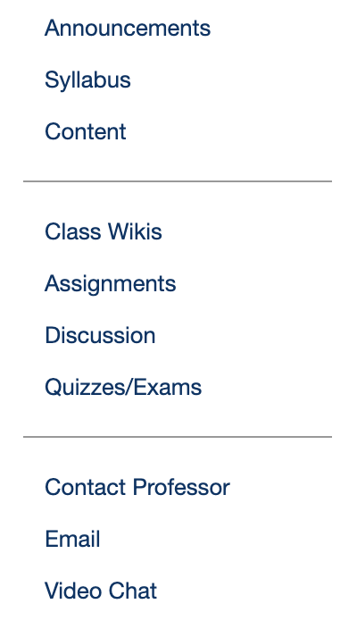
A More Agile, Adaptable Pedagogy—Organizing and Structuring Your (Suddenly) Online Course
To get started thinking about how to organize your online course,
it might be helpful to think about how, no matter your discipline,
instructors have three basic things that they do in each class:
Present your content, information,
materials, experiences to students
Receive assignments, information, ideas
from students
Communicate and interact with your
students
* It can help students if this is reflected in your course menu.
👉🏼
Notes:
Getting back to the basics helps many faculty who are getting started online.

Slide 5
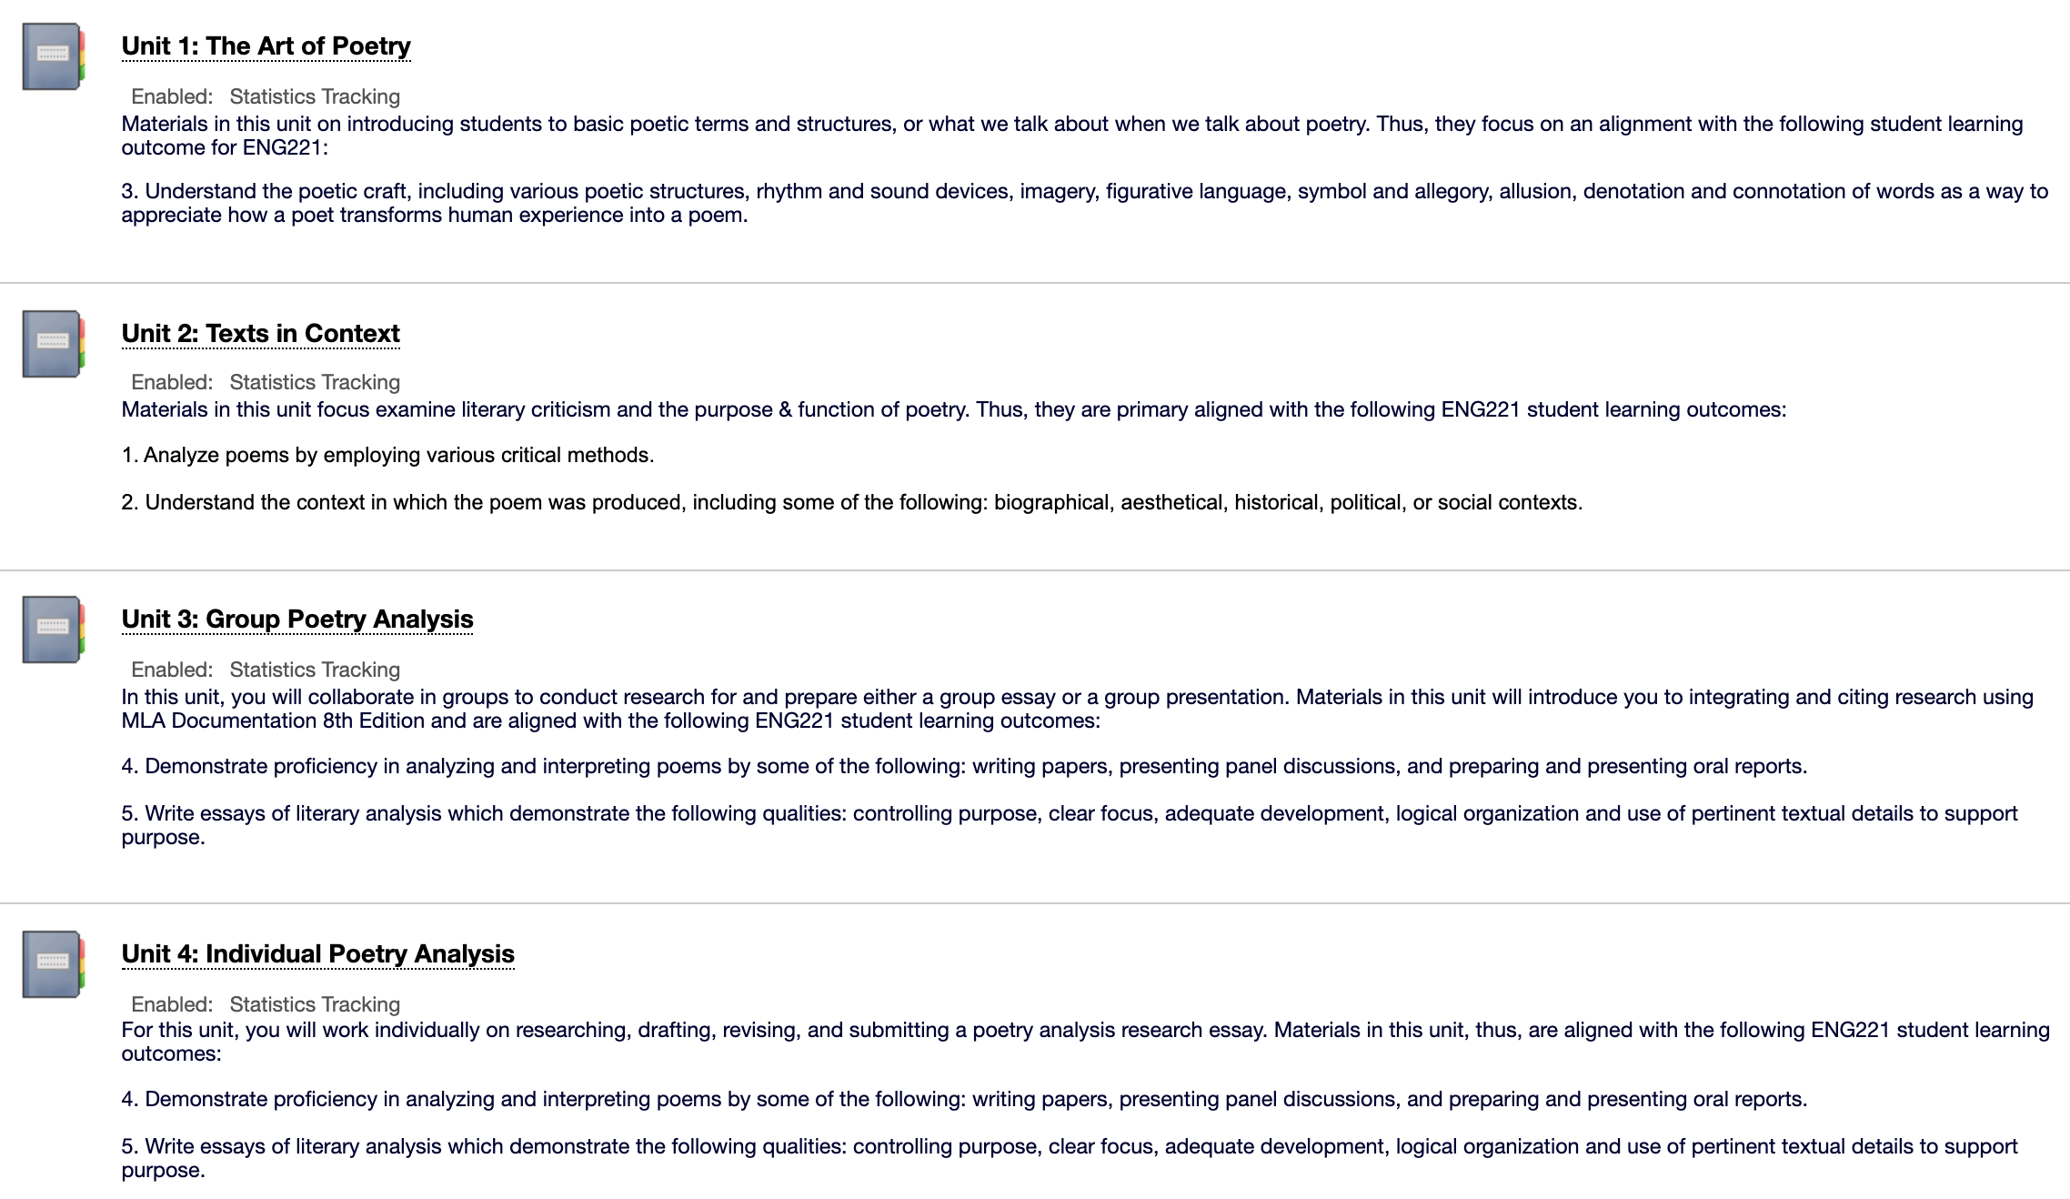
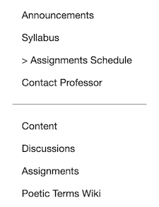
A More Agile, Adaptable Pedagogy—Some Advice for Presenting Your Content
Focus on the basics:
This is a great time
to think about
reverse design and
some basic course
mapping.
Prioritize the
student learning
outcomes.
“If they learn
nothing else this
semester, what
must they learn
and do to pass?”
Notes:
The image here shows how I put my student learning outcomes in the folder description for every unit so students can see why we’re doing what we’re doing.

Slide 6
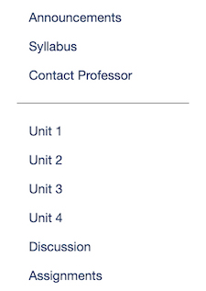
A More Agile, Adaptable Pedagogy—Some Advice for Presenting Your Content
Organize your course menu in a way that makes the most sense to your students, given your discipline, course, and level.
👈🏼
This
sample course menu maintains the default Content as the sole location of all course materials, which contains folders for each unit.
This sample course menu removes Content as a main item & adds
links to each unit right
in the
course menu.
👉🏼
Notes:
This shows just two basics ways to organize your course menu on the left side of Blackboard. Or science colleagues, for example, will delete the Content link and put Lectures and Labs as the main content links, etc. Think about how to organize your materials in a way that will make things easiest for your students to find what they need.

Slide 7

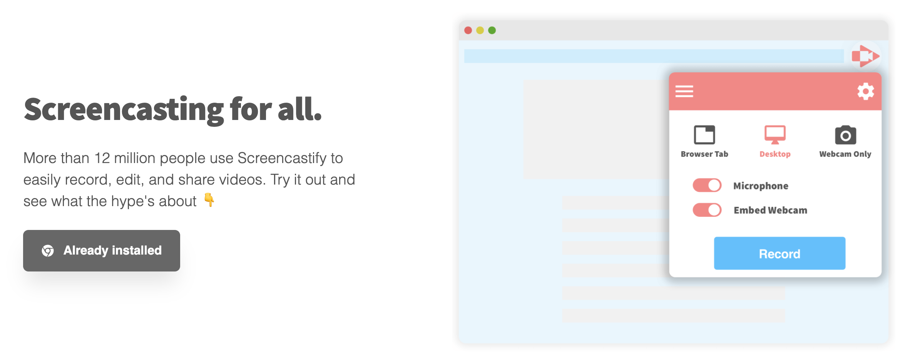
A More Agile, Adaptable Pedagogy—Some Advice for Presenting Your Content
Provide clear instructions to students about how to navigate each section of your course so they can find your content—both written and video instructions.
Notes:
It’s helpful to provide instructions for students on how to navigate your specific Bb class website since each faculty member sets things up in their own way. I’ve shared written instructions for how to use various Bb tools on the FA website (http://www.fascc.org/professionalmatters/blackboard-basics) that you can download, edit, and share with your own students. In addition, you could make video instructions by using the free program Screencastify (https://www.screencastify.com/) to record what you’re doing on your screen (you can choose video and/or audio recording).

Slide 8
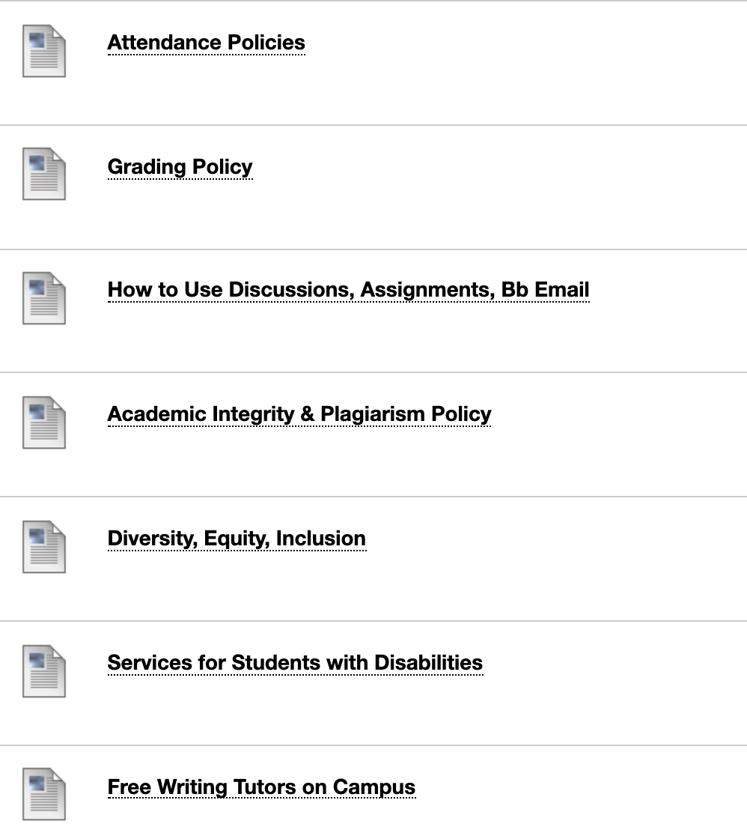
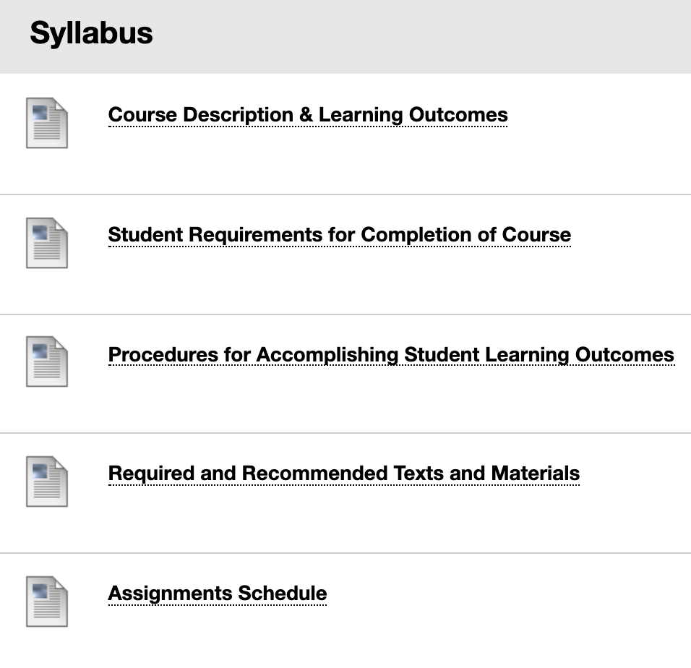
A More Agile, Adaptable Pedagogy—Some Advice for Presenting Your Content
Shorter is better! Design in the most mobile friendly and accessible manner you can.
Notes:
I break up my syllabus into separate sections/pages so it’s easier for students to access the info on mobile devices. When writing for the web, it’s best to bread up your material in several shorter pages so students don’t have to scroll down so much. This is immensely helpful to students viewing your class on a mobile device. I also put as much into Bb content > blank pages as possible rather than using attachments for this reason.

Slide 9



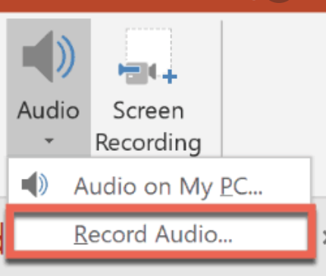

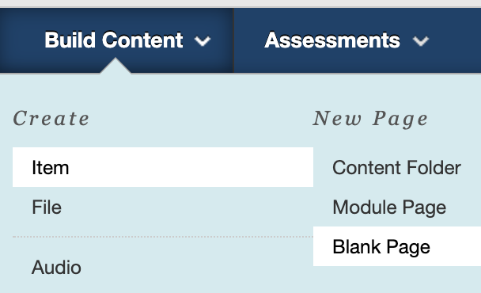
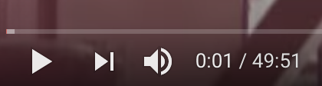
A More Agile, Adaptable Pedagogy—Some Advice for Presenting Your Content
Shorter is better! Design in the most mobile friendly and accessible manner you can.
less accessible
more accessible
most accessible
Notes:
Download and look at your course using the Bb mobile app. Long videos aren’t as friendly, and PPTs aren’t either—esp if image heavy and esp if you’re audio narrating all those slides. More accessible are Word and pdf files. Most accessible and mobile friendly are simple pages in Bb. So why not just open your Word files and copy & paste them right into the blank page feature in Bb? Or create your own YouTube channel and set it to Private (only users with link can access), then upload those to your course website.

Slide 10
A More Agile, Adaptable Pedagogy—Some Advice for Receiving Student Work
Select tools by focusing on affordances.
Rather than try to learn all of the tools in your course management system (CMS)—which can be exhausting, and
besides you don’t need all the bells and whistles—instead jot down what you need to accomplish.
Work with a knowledgeable colleague to determine which tools are best for the job. To determine affordances, I have faculty fill in sentences like this for me:
Because I need students to do __X__, I need a tool that allows me to do __Y__.
Then I can advise which CMS tool is the simplest for the task.
For example, Blackboard offers eight tools by which students could submit an essay: discussion board, assignments, email, test, blog, wiki, journal, and even Collaborate if students read it aloud.
But if I know the professor wants other students to see that essay draft, I can advise against using assignments, email,
or a test since those are accessible only to the instructor, and then I can share the pros and cons of the remaining
options.
Notes:
When advising colleagues about how to create their Bb class websites, I ask them to tell me what they need to accomplish with their students, then I can explain which tools afford them the ability to do that. This saves time versus trying to learn and master all of Bb’s tools and features.

Slide 11
A More Agile, Adaptable Pedagogy—Some Advice for Receiving Student Work
Make the most of your discussion boards.
These can quickly become stale, underused, and undervalued by students if the focus is on quantity over quality.
Try cutting the number of discussion posts overall and emphasize quality over quantity in their postings.
Whenever possible, ask students to respond to questions that require them to incorporate
  course material / textual evidence
  outside research
  their own experiential evidence.
To encourage more robust replies between and among students, consider the 3CQ approach, which requires students to go beyond the “I agree” type responses; this requires that students post a compliment, a comment, a connection, plus a question.
Use the “muddiest point” technique: Have students post the three least clear points at the end of each unit, then you can post your responses to the “ muddiest” ones.
Contact disengaged students, especially early in the semester, to encourage them to participate.
Notes:
This is some general advice about using the discussion boards. You can learn more about the muddiest point technique here (https://www.chronicle.com/interactives/20190523-ClassDiscussion) and more about the 3CQ technique here (https://www.insidehighered.com/digital-learning/article/2019/03/27/new-approaches-discussion-boards-aim-dynamic-online-learning).

Slide 12
A More Agile, Adaptable Pedagogy—Some Advice for Receiving Student Work
Make the most of quizzes and exams.
Work toward an effective mix of formative and summative assessments.
Start with a syllabus quiz to highlight the most basic, fundamental course policies and procedures; this is especially helpful for students when their professors all have different approaches.
Develop a series of formative quizzes that are more low stakes grade wise. Most CMSs allow you to embed feedback
on automatically graded quiz questions.
Use this feedback to add new information and content as part of your response and clarification. Let students know you’ll put that new information on the next exam. This better ensures they’ll go back to review their quizzes, along
with your feedback and explanations, rather than just glance at the grade and walk away.
Explore alternatives to multiple choice! Multiple answer questions are a better assessment of student knowledge,
and you can add a variety of other types (when using true/false, be sure to use the “pattern matching” feature).
Write more useful multiple choice questions by making them application questions. The less they can google the correct answer, the better your assessment.
Notes:
Here are some suggestions about making the most of the testing feature in Bb. My favorite point of advice is to embed new points of information in your feedback on each quiz-–and tell students that you’re doing so. This requires that they go back and review each quiz in the My Grades section rather than just glance at the grade and walk away. Then I embed some of the new info from the quiz feedback areas on the next exam so it’s clear to students that we’re using the quizzes as a learning tool.

Slide 13
A More Agile, Adaptable Pedagogy—Some Advice for Receiving Student Work
Make the most of written assignments.
Students don’t have to hate writing, and you don’t have to hate grading their writing.
For formal essays, provide models (sample student essays if possible) and use a tool like Screencastify to illustrate common issues and suggestions or “here’s what to do / here’s what not to do.”
Use plagiarism checking software mindfully. Design assignments that aren’t so readily plagiarized. Again, ones that incorporate course material, outside research, and experiential evidence help. Or have them do local, project-based research assignments.
Scaffold their writing by incorporating low stakes writing assignments.
Students could do collaborative writing using wikis early in the semester to establish knowledge of course terminology and add their own examples.
Students could get in the habit of writing a private journal to enhance self-reflection, improve meta-cognition, and keep practicing their writing skills. (If you assign a few points, these don’t take long to grade!)
For more social / public writing practice, consider using blogs.
Notes:
As a compositionist, I strongly encourage more writing in online courses. This doesn’t have to be as labor intensive as people generally think: you can do low-stakes writing, have students post in private journals, or work collaboratively to create wikis filled with general info all students need to succeed in the class, and or have them maintain blogs. Writing assignments don’t always have to be formal essays—although those are great too!

Slide 14
A More Agile, Adaptable Pedagogy—Some Advice for Communicating with Students
Communication is critical.
Don’t let your students feel like they’re in “a classroom of one.”
Communicate most frequently early in the semester and with the students who need the most encouragement. A brief email, even if you’re sending in bulk using BCC, can help students better comprehend how well they’re doing.
Students do not love email. Try other ways of communicating with them, e.g., private journals/discussions or blogs.
Use the CMS’s synchronous tools for online office hours with public (and private as needed) video chats.
Dial *67 and call them—the good old-fashioned telephone still works—even if you’re just leaving a voice message (students also do not love the phone).
You can use the announcements feature to share updates but also to share encouragements, helpful hints, and technology tips. You can set these up at the start of the semester so they go out on a regular weekly basis for an enhanced sense of instructor presence.
Include a FAQ discussion forum. Assign points for students who post smart questions and who answer others’ questions correctly.
Notes:
Regular, frequent communication from you is critical to help students avoid feeling like they’re isolated in a “classroom of one.” I have found that students generally do not love email, so I’ve set up private journals and check in with them there; it has helped increase the response rates. SCCC offers Bb Collaborate Ultra and MS Teams for faculty to video chat or audio chat with students as well, which is immensely helpful.

Slide 15
Contact me
Cynthia Eaton
cynthia@fascc.org
National Education Association webinars
Part 1 — A More Agile, Adaptable Pedagogy —
Designing and Organizing Your (Suddenly) Online Course
Part 2 — A More Agile, Adaptable Pedagogy —
Helping Students Develop Literacy & Self-Regulation Skills
Notes:
This is just a very general overview of some basic course design ideas. If you’d like to chat more, contact me! I’m happy to help.

